Slide 1
Project Scope Management

Slide 2
What is Project Scope Management?
Scope refers to all the work involved in creating the products of the project and the processes used to create them.
A deliverable is a product produced as part of a project, such as hardware or software, planning documents, or meeting minutes.
Project scope management includes the processes involved in defining and controlling what is or is not included in a project.

Slide 3
Project Scope Management Processes
Scope planning: Deciding how the scope will be defined, verified, and controlled.
Scope definition: Reviewing the project charter and preliminary scope statement and adding more information as requirements are developed and change requests are approved.
Creating the WBS: Subdividing the major project deliverables into smaller, more manageable components.
Scope verification: Formalizing acceptance of the project scope.
Scope control: Controlling changes to project scope.

Slide 4
Scope Planning and the Scope Management Plan
The scope management plan is a document that includes descriptions of how the team will prepare the project scope statement, create the WBS, verify completion of the project deliverables, and control requests for changes to the project scope.
Key inputs include the project charter, preliminary scope statement, and project management plan.

Slide 5
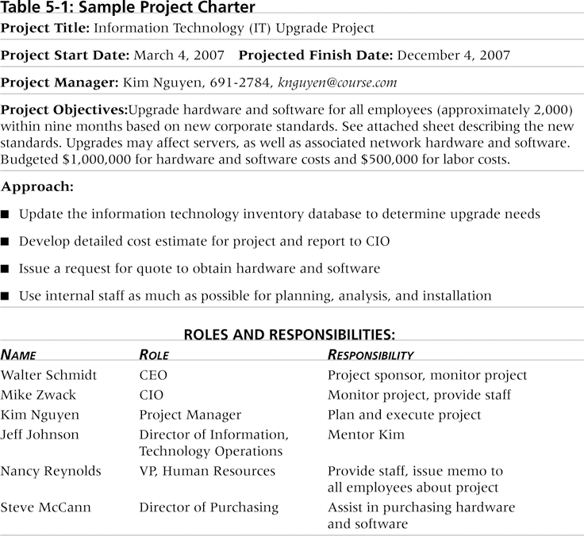
Table 5.1. Sample Project Charter

Slide 6
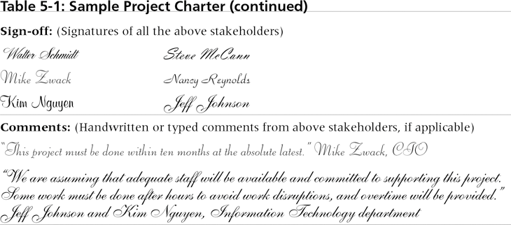
Table 5.1. Sample Project Charter (cont’d)

Slide 7
Scope Definition and the Project Scope Statement
The preliminary scope statement, project charter, organizational process assets, and approved change requests provide a basis for creating the project scope statement.
As time progresses, the scope of a project should become clearer and more specific.

Slide 8
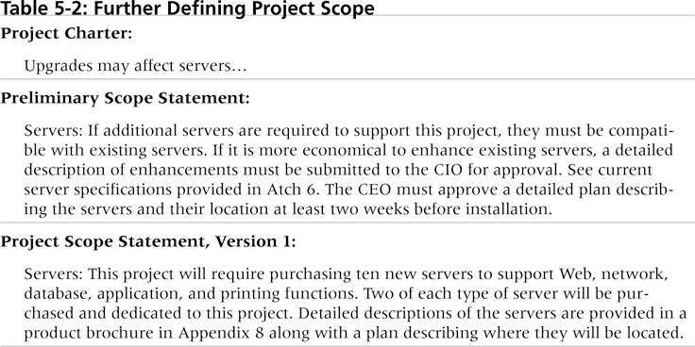
Table 5-2. Further Defining Project Scope

Slide 9
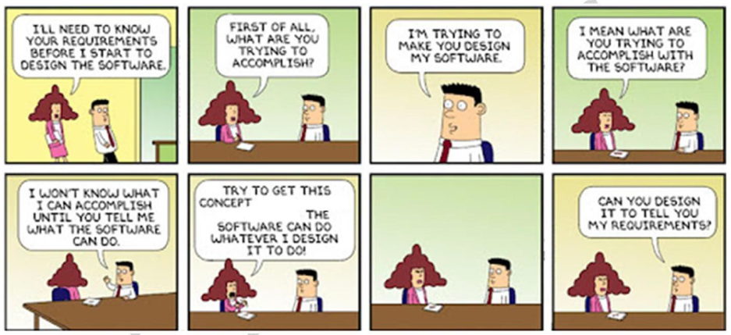
Collect Requirements

Slide 10
Creating the Work Breakdown Structure (WBS)
A WBS is a deliverable-oriented grouping of the work involved in a project that defines the total scope of the project.
A WBS is a foundation document that provides the basis for planning and managing project schedules, costs, resources, and changes.
Decomposition is subdividing project deliverables into smaller pieces.

Slide 11
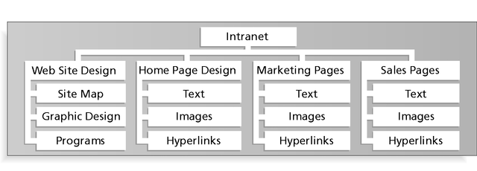
Figure 5-1. Sample Intranet WBS Organized by Product

Slide 12
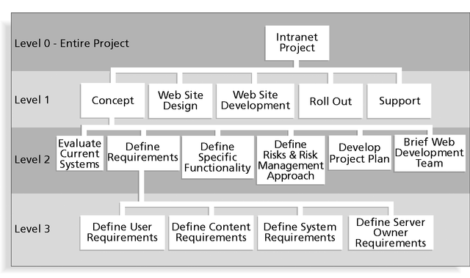
Figure 5-2. Sample Intranet WBS Organized by Phase

Slide 13
Table 5-3. Intranet WBS in Tabular Form
1.0 Concept
1.1 Evaluate current systems
1.2 Define requirements
1.2.1 Define user requirements
1.2.2 Define content requirements
1.2.3 Define system requirements
1.2.4 Define server owner requirements
1.3 Define specific functionality
1.4 Define risks and risk management approach
1.5 Develop project plan
1.6 Brief Web development team
2.0 Web Site Design
3.0 Web Site Development
4.0 Roll Out
5.0 Support

Slide 14
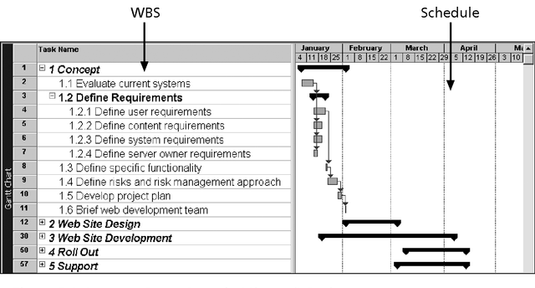
Figure 5-3. Intranet WBS and Gantt Chart in Project 2000
Project 98 file

Slide 15
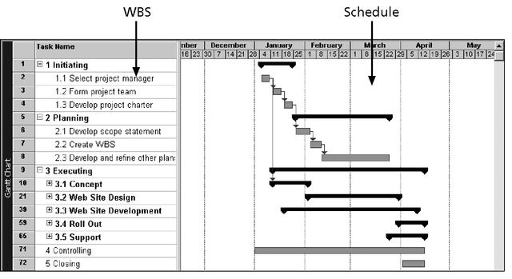
Figure 5-4. Intranet Gantt Chart Organized by Project Management Process Groups

Slide 16
Approaches to Developing WBSs
Guidelines: Some organizations provide guidelines for preparing WBSs.
Analogy approach: Review WBSs of similar projects and tailor to your project.
Top-down approach: Start with the largest items of the project and break them down.
Bottom-up approach: Start with the specific tasks and roll them up.
Mind-mapping approach: Write tasks in a non-linear, branching format and then create the WBS structure.

Slide 17
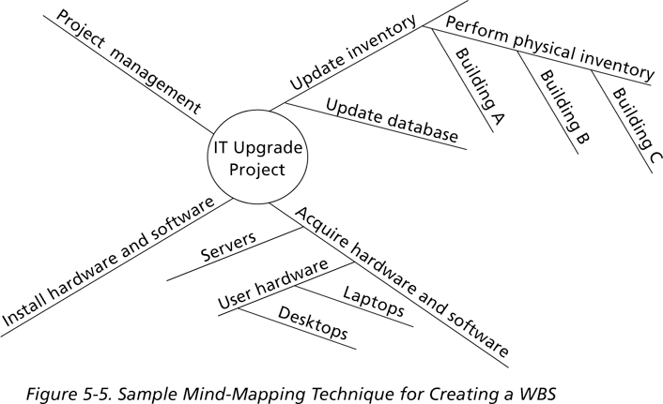
Figure 5-5. Sample Mind-Mapping Approach

Slide 18
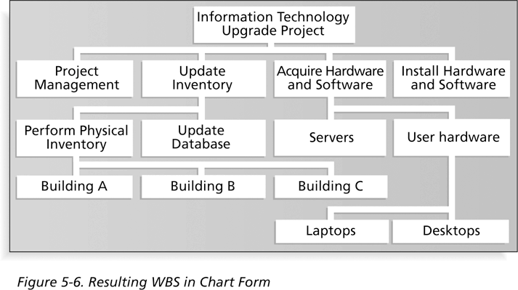
Figure 5-6. Resulting WBS in Chart Form

Slide 19
The WBS Dictionary and Scope Baseline
Many WBS tasks are vague(unclear) and must be explained in more detail so people know what to do and can estimate how long the work will take and what it will cost.
A WBS dictionary is a document that describes detailed information about each WBS item.
The approved project scope statement and its WBS and WBS dictionary form the scope baseline, which is used to measure performance in meeting project scope goals.

Slide 20
Advice for Creating a WBS and WBS Dictionary*
A unit of work should appear in only one place in the WBS.
The work content of a WBS item is the sum of the WBS items below it.
A WBS item is the responsibility of only one individual, even though many people may be working on it.
The WBS must be consistent with the way in which work is actually going to be performed; it should serve the project team first, and other purposes only if practical.
*Cleland, David I., Project Management: Strategic Design and Implementation, 2nd edition (New York: McGraw-Hill 1994).

Slide 21
Advice for Creating a WBS and WBS Dictionary (cont’d)*
Project team members should be involved in developing the WBS to ensure consistency and buy-in.
Each WBS item must be documented in a WBS dictionary to ensure accurate understanding of the scope of work that is included and not included in that item.
The WBS must be a flexible tool to accommodate inevitable(Unavoidable) changes while properly maintaining control of the work content in the project according to the scope statement.
*Cleland, David I., Project Management: Strategic Design and Implementation, 2nd edition (New York: McGraw-Hill 1994).

Slide 22
Scope Verification
It is very difficult to create a good scope statement and WBS for a project.
It is even more difficult to verify project scope and minimize scope changes.
Many IT projects suffer from scope creep and poor scope verification
FoxMeyer Drug filed for bankruptcy after scope creep on a robotic warehouse.

Slide 23
Scope Control
Scope control involves controlling changes to the project scope.
Goals of scope control are to:
Influence the factors that cause scope changes.
Ensure changes are processed according to procedures developed as part of integrated change control.
Manage changes when they occur.
Variance is the difference between planned and actual performance.

Slide 24
Suggestions for Improving User Input
Develop a good project selection process and insist that sponsors are from the user organization.
Place users on the project team in important roles.
Hold regular meetings with defined agendas, and have users sign off on key deliverables presented at meetings.
Deliver something to users and sponsors on a regular basis.
Don’t promise to deliver when you know you can’t.

Slide 25
Suggestions for Reducing Incomplete and Changing Requirements
Develop and follow a requirements management process.
Use techniques such as prototyping,
Put requirements in writing and keep them current.
Create a requirements management database for documenting and controlling requirements.

Slide 26
Suggestions for Reducing Incomplete and Changing Requirements (cont’d)
Conduct adequate testing throughout the project life cycle.
Review changes from a systems perspective.
Emphasize completion dates to help focus on what’s most important.
Allocate resources specifically for handling change requests and enhancements.

Slide 27
Chapter Summary
Project scope management includes the processes required to ensure that the project addresses all the work required—and only the work required—to complete the project successfully.
Main processes include:
Scope planning
Scope definition
WBS creation
Scope verification
Scope control

Slide 28
Assignment # 1
For Your Project Prepare:
Business Case
Project Charter
Stakeholder Register
Individual Assignment

